Slide 1
ASI Alcohol Composite Analysis- Cocaine Treatments and Livelihoods
Daniel O’Callaghan

Slide 2
Background
We will be looking at a study of 487 patients that were assigned to 4 different manually guided treatments for cocaine: strictly group drug counseling (GDC), cognitive therapy plus GDC, individual drug counseling with GDC, or supportive expressive therapy plus GDC.
For our analysis we will be primarily looking at the reports made after 3 months of treatment and 6 months of treatment
Within our analysis we will be looking at how the treatments affected a patient’s alcohol usage
To measure a patients we used the Addiction Severity Index (ASI) for alcohol abuse which is a measure scored from a questionnaire administered by clinicians.
ASI scoring is based on a series of yes or no scorings where yes/no is signified as 1s and 0s and a total score is calculated. The higher the final score, the higher the need for treatment.

Slide 3
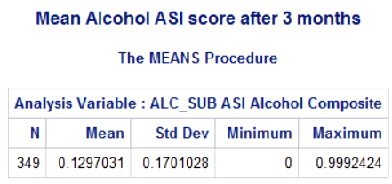
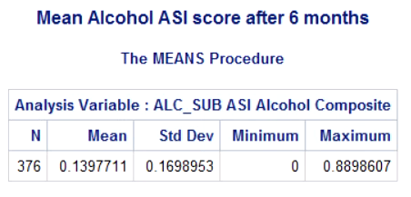
Average Score per Treatment

Slide 4
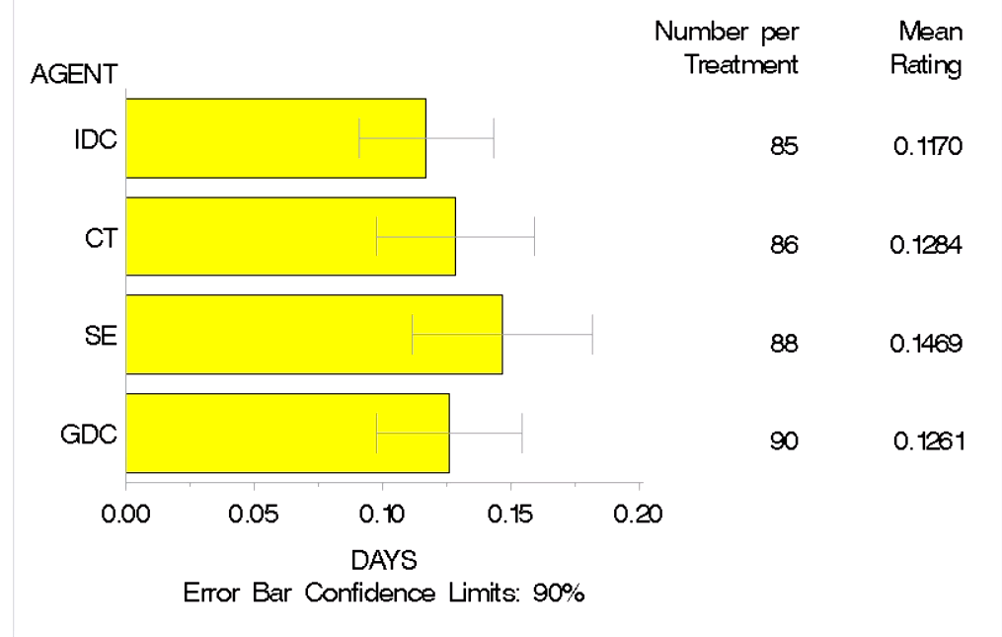
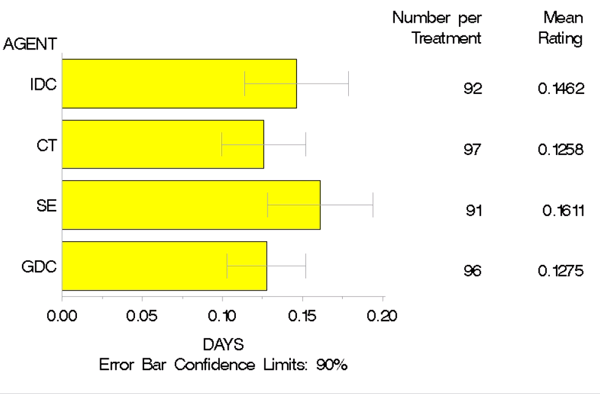
Mean ASI Alcohol Composite by Treatment
Three Month
Six Month

Slide 5
Test Assumptions- One way analysis of treatment type for ASI Alcohol Composite
For both 6 month and 3 month results: After testing for homogeneity of variance, the levene’s test proves to be nonsignificant meaning we do have sufficient evidence to state there is homogeneity of the variance. However, our normality of the residuals. After applying a boxcox test on the alcohol ASI (adding a factor of 1 since there exists alcohol ASI scores of 0), we still do not find sufficient evidence to state normality of the residuals proceed to our findings with caution
No autocorrelation is testing either month

Slide 6
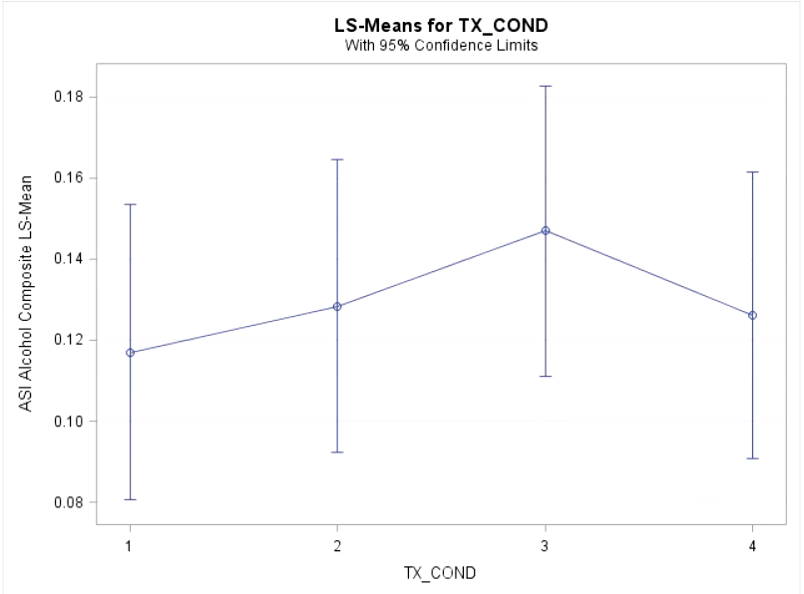
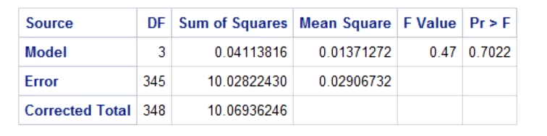
3-month One Level Analysis for Alcohol Usage
With a p-value of .7022, there is not significant evidence to say that the mean ASI Alcohol Composite is different between the 4 treatment methods. As seen in the graph the alcohol composite score tends to stay around the range of .11-.15

Slide 7
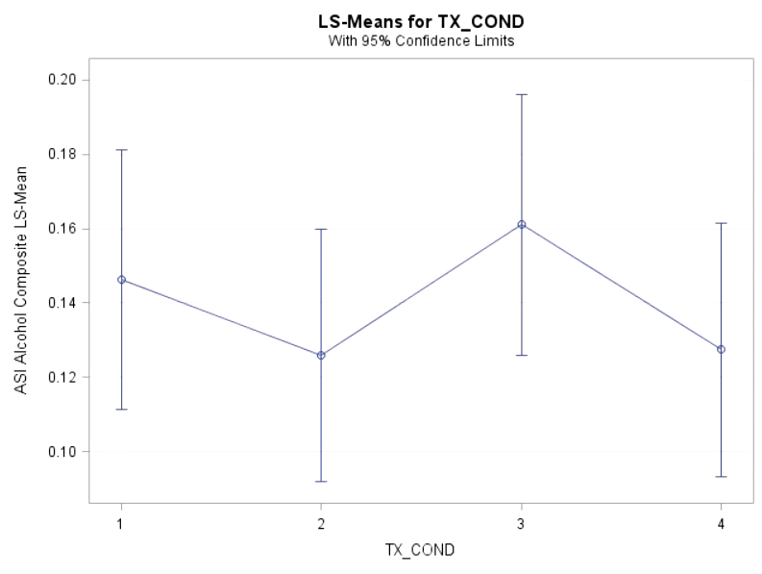
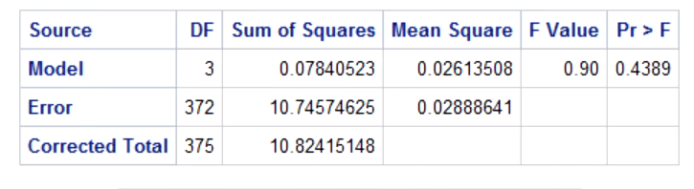
6-month One Level Analysis for Alcohol Usage
With a p-value of .4389, there is not significant evidence to say that the mean ASI Alcohol Composite is different between the 4 treatment methods. As seen in the graph the alcohol composite score tends to stay around the range of .13-.16

Slide 8
Analyzing Interactions
For our interactions, I was interested in investigating how different livelihoods affected the treatment groups and ASI Alcohol Composite.
Therefore, our two- way interaction will involve Marriage Status/treatment group
Our 3-way interaction will involve race, marriage status, and treatment group

Slide 9
Check Assumptions for 2 way interaction
For both 6 month and 3 month results: After creating an Ofata variable, both the 6 month and 3 month 2-way tests we performed a Levene’s test to find we do have sufficient evidence to state there is homogeneity of variance. However, our normality of the residuals. After applying a boxcox test on the alcohol ASI (adding a factor of 1 since there exists alcohol ASI scores of 0), we find the best transformation is lambda=-3. However this produced a non normal residuals so we will proceed to our findings with caution
Positive autocorrelation was detected in the 3 month analysis. Due to the randomization of the patients I am not worried by a lack of independence, but this is something I would bring up to the subject testers

Slide 10
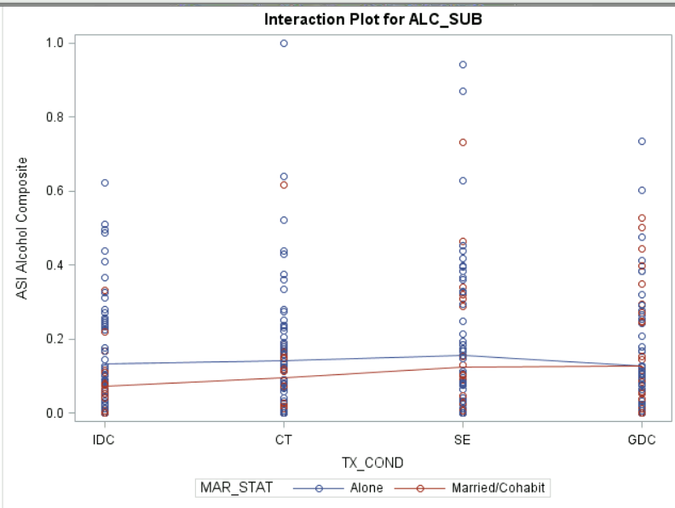

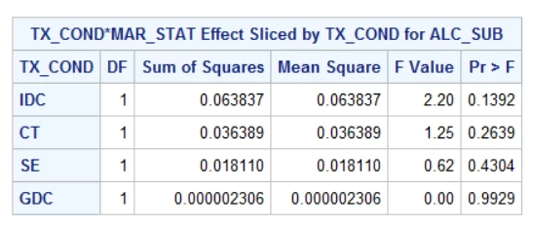
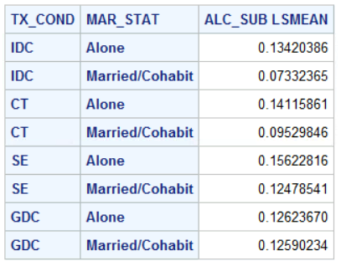
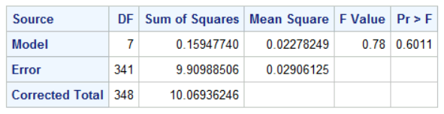
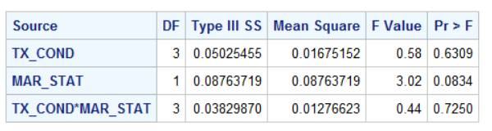
Interaction of Treatment and Marriage Status (3-month)
After looking at the overall two-way ANOVA we have found that there is not a significant difference in the factor level means of the ASI Alcohol Composite
Delving deeper, we can see that among the levels of Treatment Groups, the levels of Marriage Status, and this interaction proved to be insignificant
Looking at the graph and the LS Means, I noticed that the difference between Marriage status was way bigger in IDC than in GDC
This Difference becomes more clear when we start to see how much larger the slice of IDC is compared to the slice of GDC
However, after using a contrast to test the difference of ASI Alcohol Composite for IDC vs the difference of Alcohol Composite for GDC the difference ended up being nonsignificant

Slide 11
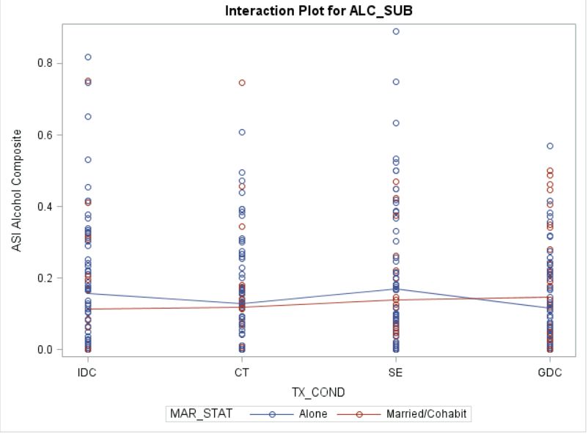
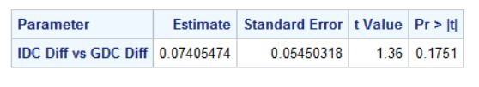
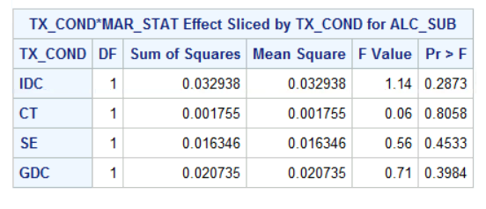
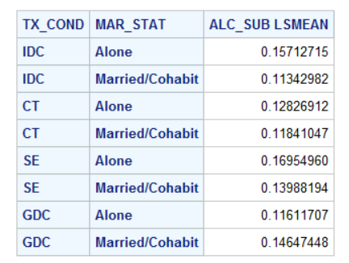
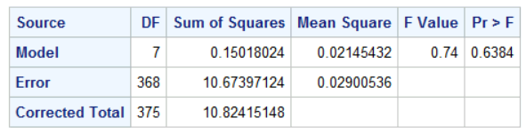
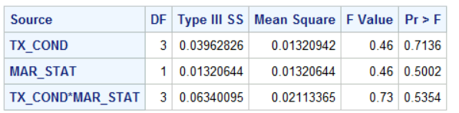
Interaction of Treatment and Marriage Status (6-month)
After looking at the overall two-way ANOVA we have found that there is not a significant difference in the factor level means of the ASI Alcohol Composite
Although we once again do not see any significant interaction or differences among the levels of tx_cond and marriage status, we do gain a story. The marriage status and treatment condition are even less significant when brought into the 6 month data. However, the interaction term became even more significant
This is evident in the graph, as even though the split is not significant, we can see that the ASI Alcohol Composite for GDC for Married patients are larger than the alone patients, something that has not happened in the entirety of the data so far.
The graph and LS Means statements also explain why the significance of Marriage and Treatment condition fell so much, as all of the means are in the range of .11-.17
However, after using a contrast to test the difference of ASI Alcohol Composite for IDC vs the difference of Alcohol Composite for GDC the difference ended up being nonsignificant

Slide 12
Testing Assumptions for 3-way interaction of race, marriage status, and treatment group
For both 6 month and 3 month results: After creating an Ofata variable, both the 6 month and 3 month 2-way tests we performed a Levene’s test to find we have sufficient evidence to state there is homogeneity of variance. However, our normality of the residuals. After applying a boxcox test on the alcohol ASI (adding a factor of 1 since there exists alcohol ASI scores of 0), we find the best transformation is lambda=-3. However this produced a non normal residuals so we will proceed to our findings with caution
Positive autocorrelation was detected in the 3 month analysis. Due to the randomization of the patients I am not worried by a lack of independence, but this is something I would bring up to the subject testers

Slide 13
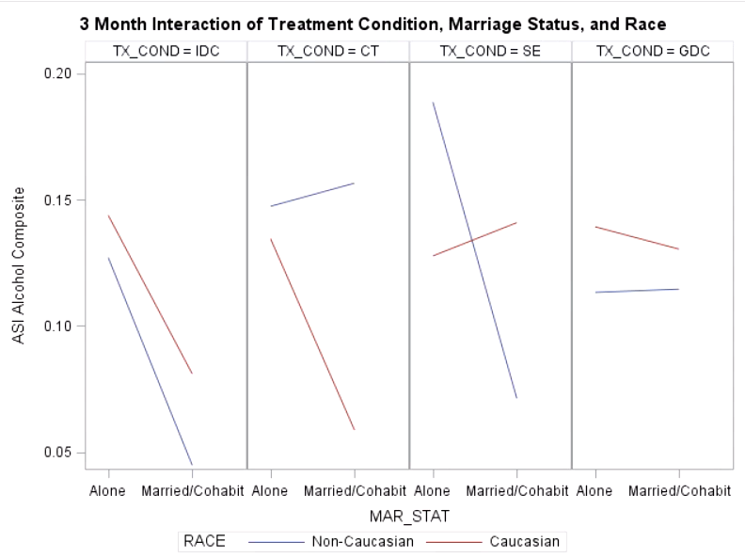
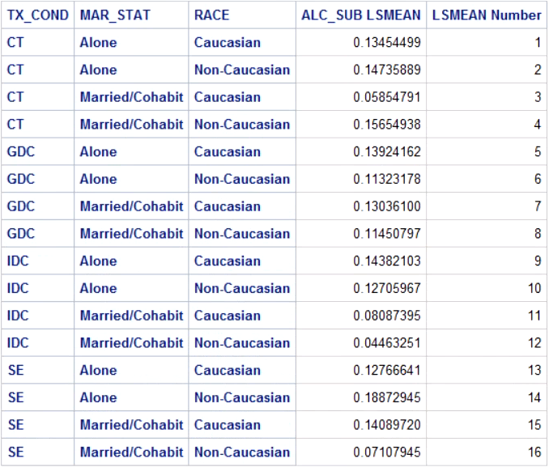
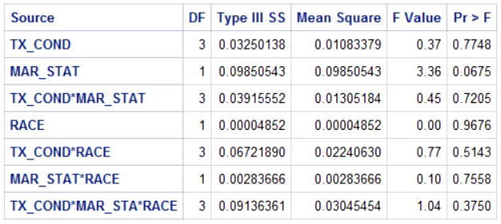
3 Month Interaction of Treatment, Marriage, and Race
Looking at our p-values, none of the interactions or effects produce a significant difference in mean ASI Alcohol Composite across the levels of marriage status, treatment, or race.
However in our graph we do see a very interesting relationship between marriage status, race, and treatment in that supportive expressive therapy is the only treatment condition where Caucasian mean ASI Alcohol Composite goes up from alone to married.
Despite the interesting observation, after doing the contrast neither GDC, nor IDC, nor SE produced a significant difference in Caucasian Marriage Status

Slide 14
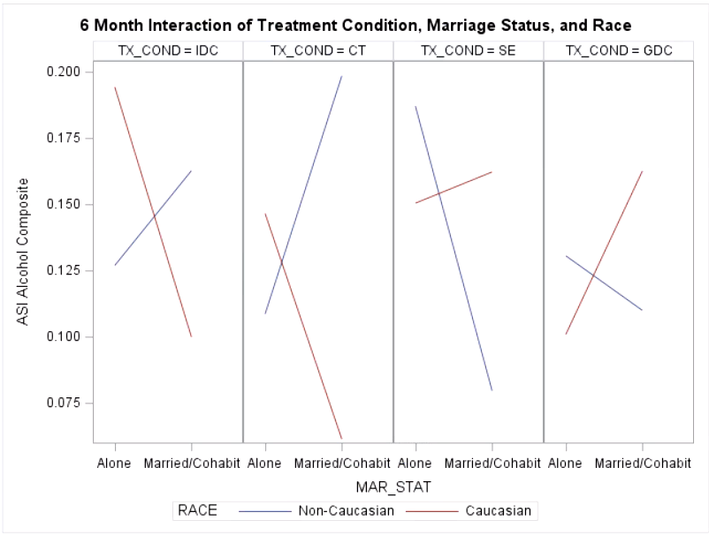
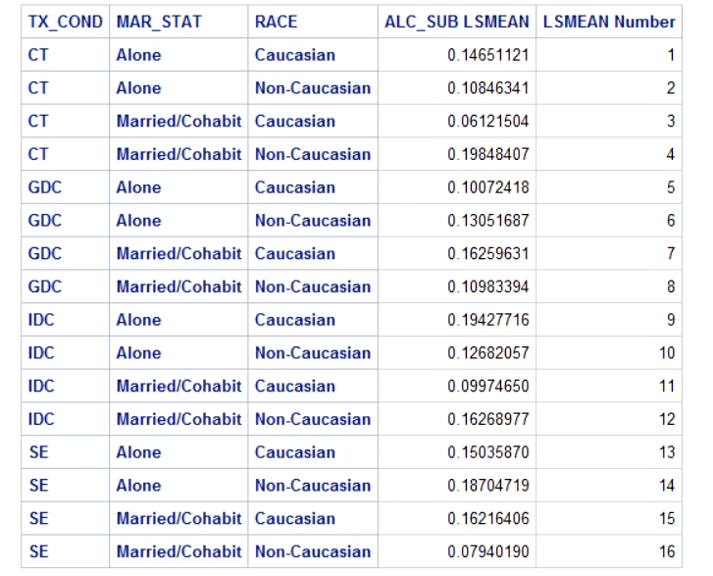
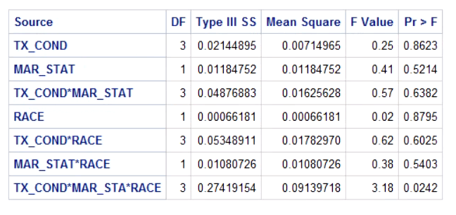
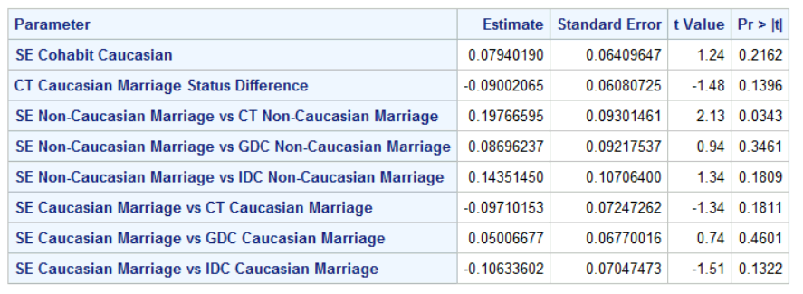
6 Month Interaction of Treatment, Marriage, and Race
Despite many variables such as marriage status and treatment status alone becoming less significant. Very interestingly, our three way interaction of treatment, marriage status, and race is significant!
This can be further seen within our graphs as for the CT and IDC variables we see massive declines in mean ASI Alcohol Composite for Caucasian patients when going from alone to married, but we see rises for this same race for SE and GDC treatments. The same goes for the other way around as IDC and CT have increases in ASI Alcohol Composite for Alone to Married in Non-Caucasian treatments but we see
Unlike in 3 month the biggest discrepancies seems to be in Non-Caucasians Marriage status among the 3 treatments. After testing, I found that the difference in Alone vs Married SE Non-Caucasians is significantly different than the difference in Alone vs Married CT Non-Caucasians
For consistency’s sake I also tried to test the difference for Caucasians between the 3 treatment groups vs SE but did not find anything significant

Slide 15
Conclusions
Overall, I found the ASI Alcohol Composite to be mostly unaffected by the treatment groups and different livelihoods
However, what seemed to be the biggest highlight from the data is that the supportive expressive therapy seemed to always have an interesting effect on married vs alone couples when it pertains to race.
Delving deeper, it appears that the biggest difference between treatments was between Supportive Expressive Therapy vs Cognitive Therapy when interacting with Race and Marriage Status
Finally, I think a more interesting analysis for this variable would be to see how the ASI Alcohol Index changes over a set period as the means between 3-month and 6-month datasets never seemed to stay consistent with one another.

